Slide 1
Real-Time Deepfake Detection
Developing an AI-based tool for identifying deepfakes on social media.
PRESENTED BY Arya Goyal, Manvi Pandya, Sanam Palsule

Slide 2
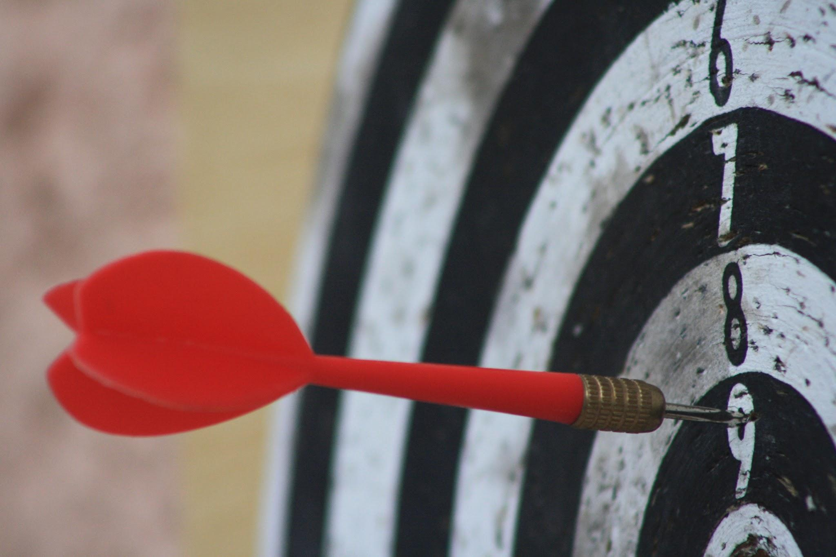
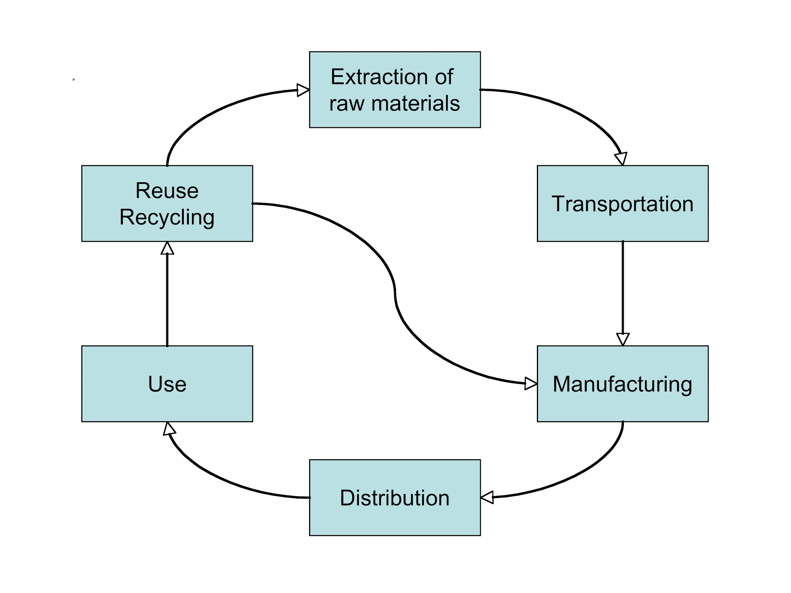

Project Overview
0 1 . Objective
Real-time detection of deepfake content on social media.
0 2 . Approach
Leverage LSTM, Transformers, CViT, GAN
Utilize GPU acceleration (CUDA, CuDNN) for high-speed analysis.
.
0 3 . Goal
Provide a scalable, user-friendly solution for content moderation.

Slide 3
Dataset Specifications:
Celeb-DF v2
The dataset includes deepfake video clips where the faces of celebrities are swapped with those of other people.
Original Dataset: Around 590 real videos and 5,639 deepfake videos.
Includes 59 celebrities, from diverse backgrounds (age, gender, ethnicity).
Total size: Approximately 200GB when uncompressed.
Format : MP4
Real and Fake Structure:
Real Videos: Genuine videos of individuals.
Fake Videos: Deepfake-generated videos.

Slide 4
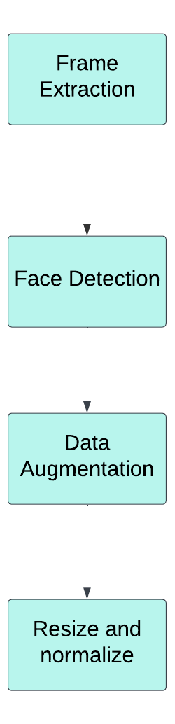
Data Preprocessing
Frames are extracted using OpenCV’s cv2.VideoCapture at a fixed rate (e.g., 1 frame per second) to ensure consistent sampling across videos.
Used MTCNN to detect bounding boxes for faces.
Flipping (horizontal or vertical)
Rotation or scaling
Brightness/contrast adjustments
Adding Gaussian noise
Resized the augmented faces to 224x224.
Normalized pixel values using the mean and standard deviation of ImageNet

Slide 5
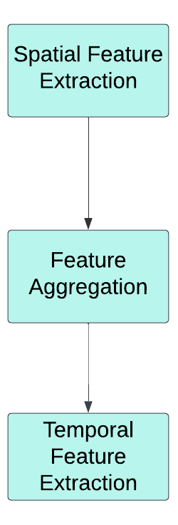
Feature Extraction
Loaded Preprocessed Frames
Passed Through ResNet-50
Saved extracted features as .npy files
Loaded frame-level spatial features.
Sorted frames in temporal order.
Combined into a 2D matrix (num_frames, 2048)
Saved aggregated features for each video
Loaded aggregated features and pad sequences for uniformity.
Added Positional Embeddings
Modelled Temporal Relationships
Applied global average pooling to condense temporal features
Used the final feature representation to classify videos as real or fake

Slide 6
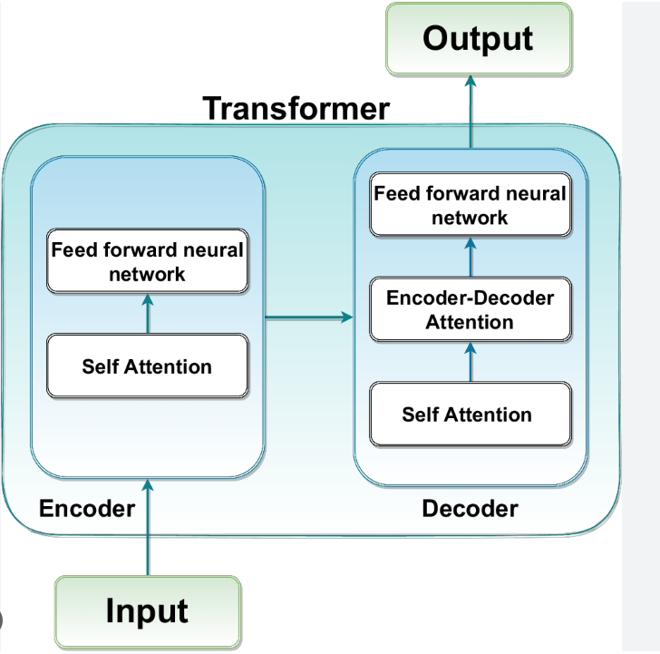
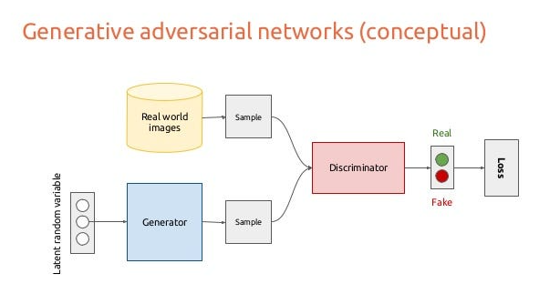
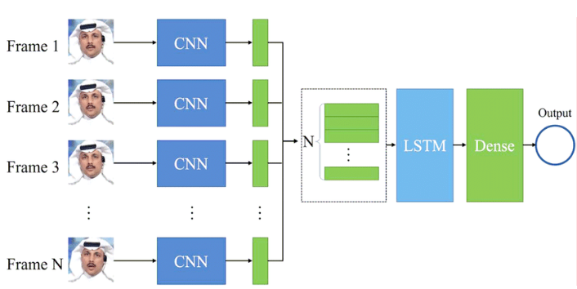
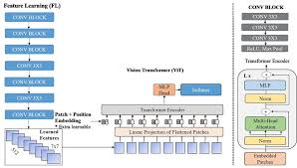
Model Development
LSTM (Temporal Modeling)
Captures temporal relationships between consecutive frames.
GAN (Generative Adversarial Network)
Generates synthetic data and refines model robustness by distinguishing between real and synthetic video features.
Temporal Transformer (Advanced Temporal Modeling)
Analyzes dependencies between frames using self-attention mechanisms.
Vision Transformer (ViT) for Temporal Analysis
Applies self-attention to analyze frame sequences, capturing long-range temporal dependencies in video data.

Slide 7
LSTM
Model Summary
Key Features
Input Shape: (num_frames, 2048) (padded sequences).
Output: Binary classification (real or fake).
Uses an LSTM layer with 128 hidden units for sequence processing.
Includes dropout layers for regularization.
The final dense layer outputs a binary classification (real or fake).
Notes:
A sequential model designed to process temporal data (e.g., videos) by learning long-term dependencies.Uses an LSTM layer with 128 hidden units for sequence processing.
Includes dropout layers for regularization.

Slide 8
Temporal Transformer
Model Structure
Key Features
Input: (num_frames, 2048) feature matrix for each video.
Positional Embeddings: Adds position-specific information to the frame features.
Attention Layers: Capture temporal dependencies and relationships.
Output: Classification probabilities for real or fake.
Includes multiple transformer layers with self-attention and feedforward sub-layers.
Applies global average pooling to condense temporal features into a single representation.
Uses a classification head to determine whether the video is real or fake.
Notes:
Processes video as a sequence of frame-wise feature vectors (e.g., (num_frames, 2048)), adds positional embeddings, and uses multiple Transformer layers with self-attention and feedforward networks.
Captures temporal dependencies, condenses features via global average pooling, and outputs classification probabilities (

Slide 9
GAN (Generative Adversarial Network)
Model Summary
Key Features
Generator:
Takes a latent vector (random noise) as input.
Outputs synthetic features that resemble real data.
Discriminator:
Takes real and synthetic data as input.
Outputs a probability indicating whether the data is real or fake.
GAN: Combines the generator and discriminator into a single model for adversarial training.
Includes both a generator and a discriminator.
The generator creates synthetic data, while the discriminator distinguishes between real and synthetic data.
Used for tasks like data augmentation or improving model robustness.
Notes:
Consists of two components— a Generator and a Discriminator—working in opposition during adversarial training. The generator learns to produce more realistic data by "fooling" the discriminator, while the discriminator simultaneously improves its ability to detect fake data.

Slide 10
Vision Transformer (ViT)
Model Summary
Key Features
An advanced transformer-based model designed to process temporal sequences.
Used for analyzing frame-level feature vectors in video classification tasks.
Feature Embedding: Projects 2048-dimensional frame features into a lower-dimensional space for transformer processing.
Positional Embedding: Adds temporal information to the feature embeddings.
Transformer Layers: Comprise self-attention and feedforward networks.
Global Average Pooling: Condenses the sequence into a single feature vector.
Classification Head: Outputs probabilities for the video being real or fake.
Notes:
Efficiently captures spatial and temporal patterns in video sequences by leveraging self-attention mechanisms..
Feature Embedding:
Projects high-dimensional frame features (e.g., 2048) into a lower-dimensional space suitable for transformer input.
Positional Embedding:
Adds temporal or positional context to feature embeddings for sequence understanding.
Transformer Layers:
Utilize self-attention and feedforward networks to capture dependencies and relationships.
Global Average Pooling:

Slide 11
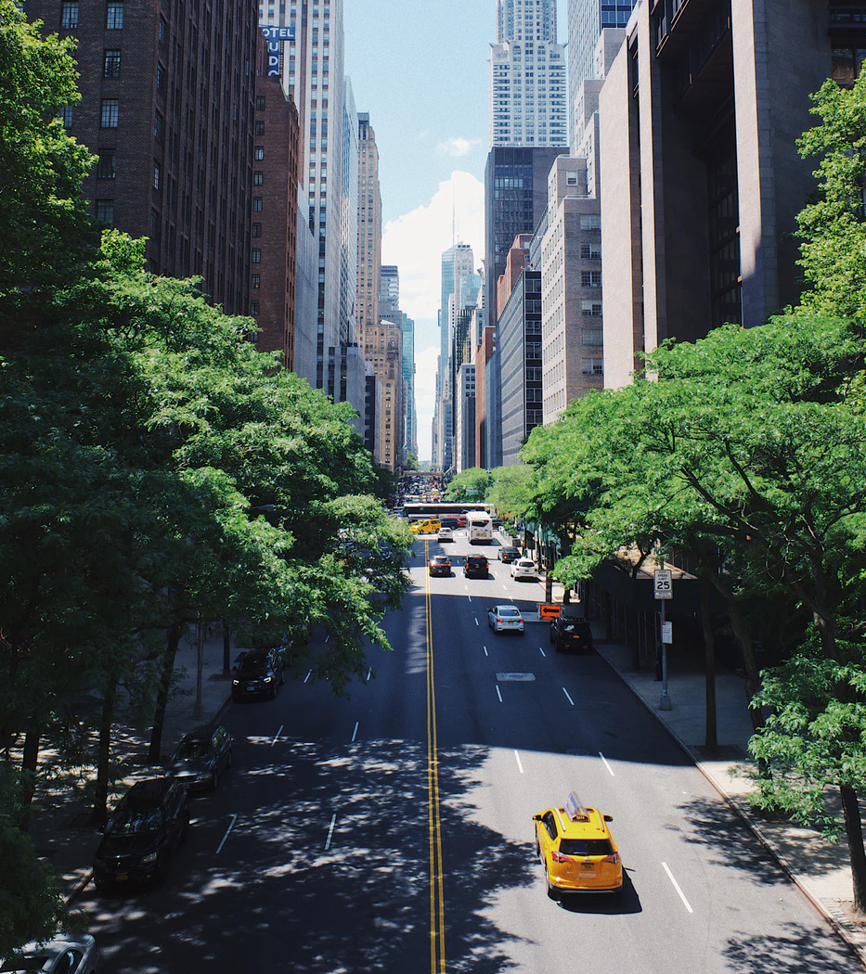
Optimization
- CUDA and CuDNN employed for GPU acceleration.
- Enhanced model training and inference speed.
- Scalability for real-time, large-scale deployment.

Slide 12
Current Progress
1 . Frame extraction and preprocessing implemented.
2 . Initial ResNet50 and LSTM models developed for spatial and temporal analysis.
3 . GAN, Transformers and Vision Transformers implemented and tested on a very small portion of dataset.

Slide 13
Challenges Faced
Dataset Processing Challenges
Overfitting in Temporal Models
Temporal Dependency Complexity
Processing such a large dataset was computationally intensive and storage-heavy, limiting our ability to run experiments on the full dataset. Instead, for now, we used a subset of the data to balance resource constraints with model development needs.
Due to the relatively small size of the subset dataset used for training, temporal models like LSTMs and Transformers occasionally showed signs of overfitting. This was worsened by the complexity of these models and the limited variety of temporal patterns in the smaller dataset.
For videos with high frame counts, capturing meaningful transitions while avoiding redundant information in sequential data was a significant challenge.

Slide 14
Next Steps
1 . Integrate GPU acceleration for improved processing times.
2 . Explore hyperparameter tuning to improve robustness.
3 . Test the system on large-scale datasets with real-world scenarios.
4 . Integrate the tool with social media platform APIs.

Slide 15
Thank You!

